Slide 1
Python Learning break your #excel addiction
Part-2

Slide 2
Python for Finance
http://www.ebooksbucket.com/uploads/economicsandfinance/finance/Python_for_Finance.pdf
http://pandas.pydata.org/pandas-docs/stable/
http://pbpython.com/excel-pandas-comp.html
http://pandas.pydata.org/pandas-docs/stable/10min.html#selection-by-label
http://pandas.pydata.org/pandas-docs/stable/cookbook.html#cookbook
http://synesthesiam.com/posts/an-introduction-to-pandas.html

Slide 3
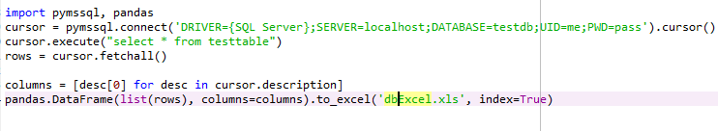
One liner programming for database to excel

Slide 4
One liner programming for REST APIs to excel

Slide 5
Pandas: Export Data
df.to_csv(‘jsonExcel.csv', index=False)
df.to_excel('jsonExcel.xls', index=False)
df.to_csv('jsonExcel.txt', index=False)
Pandas: Import data
df = pd.read_excel("sample-salesv3.xlsx")

Slide 6
Play with excel: Adding a Sum to a Row
In Excel, pretty straightforward formula
- sum(G2:I2) in column J
In Pandas
- df["total"] = df["Jan"] + df["Feb"] + df["Mar"]
Appending a column sum as a new row
- refer code example
group By clause

Slide 7
Column level analysis
Sum
- df["Jan"].sum()
Mean
- df["Jan"].mean()
Min
- df["Jan"].min()
Max
- df["Jan"].max()

Slide 8
Filtering the data
df[df["account number"]==307599]
df[df["quantity"] > 22].head()
Use map to filter some complex filtration
- refer code examples for better understanding
“isin” Function to define list of criteria values
- refer code examples

Slide 9
Working with Dates
Complex filtration with dates is supported
Partial filter with dates
Pandas understands quite well
- see code examples
df[df['date'] >='20140905'].head()
df[df['date'] >='2014-03'].head()
df[(df['date'] >='20140701') & (df['date'] <= '20140715')].head()
And many more…

Slide 10
Additional string functions
support for vectorized string functions as well
- contains function to search within cell value
- see code examples
Find list of unique items in list
- use of unique function
- df["name"].unique()
- view code examples
Slice list of columns
- Example: first and second columns ix[:,[0,1]]

Slide 11
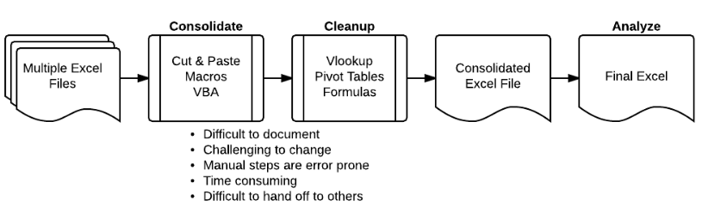
Combining Data From Multiple Excel Files
automate the process of aggregating data from multiple files and spreadsheets
Traditional style

Slide 12
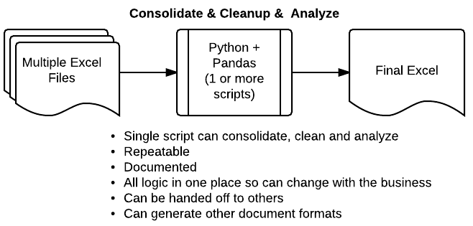
Python + Pandas: A Great Alternative
much more scaleable and powerful

Slide 13
Pivot Table
powerful tool to summarize and present data
important to understand your data
Can produce very powerful analysis very quickly
Example: sales pipeline
- How much revenue is in the pipeline?
- What products are in the pipeline?
- Who has what products at what stage?
- How likely are we to close deals by year end?
Normally companies uses some CRM tool or Excel to solve, analyze or summarize the data

Slide 14
Pandas as solution ☺
Quicker (once it is set up)
Self documenting (look at the code and you know what it does)
Easy to use to generate a report or email
More flexible because you can define custom aggregation functions
DataFrame.pivot_table(data, values=None, index=None, columns=None, aggfunc='mean', fill_value=None, margins=False, dropna=True, margins_name='All')
Official link
http://pandas.pydata.org/pandas-docs/stable/generated/pandas.DataFrame.pivot_table.html

Slide 15
Columns Vs Values
Columns are optional and used to segment the actual values we care about
Values are used to apply aggregate functions

